Slide 1
DATA MIGRATION PROJECT
by
EMMANUEL VICTOR CHIBUNDU
TECH 1M DATA ANALYSIS BOOTCAMP

Slide 2
PROJECT OVERVIEW
Title: DATA MIGRATION
Analytics Tools: MICROSOFT EXCEL, POWER BI, PYTHON, SQL
Github Link: https://github.com/EVhiktor60/DATA-MIGRATION-ANALYSIS-CUSTOMER-DATA-.git
https://github.com/EVhiktor60/DATA-MIGRATION-ANALYSIS-CUSTOMER-DATA-.git

Slide 3
PROJECT OUTLINES
Introduction
Data Exploration and Analysis
Statement of Problem and Objectives
Data Description
Solution Method
Data Visualization
Summary and Conclusion

Slide 4
INTRODUCTION
As a business grows and generates more data, it becomes increasingly important to have a robust data management system in place. Most times, it might have put in place, a data management system that is used for all the basic data-gathering needs. In most cases, Microsoft Excel is employed.
But, as the business expands, there is a need to manage the data properly for the following reason;
To Improve Data Quality, and minimize potential errors.
Increased Research Efficiency
Better Customer Insight
Reduce security risk and ensures better data compliance.
Overall, a robust data management system is essential for any business that wants to stay competitive, make better decisions, and protect its data.

Slide 5

STATEMENT OF PROBLEM AND OBJECTIVES
STATEMENT OF PROBLEM
Bad data management can have a negative impact on a business. It can slow down operations and make it difficult to make informed decisions.
OBJECTIVES
Use analytical tools to create a database and import data.
To generate insights from the data.
To proffer solutions and strategy from the insights generated.

Slide 6
DESCRIPTION OF DATA
The data provided by the business is a singular table dataset of Ten Thousand (10000) entries that offer details of customers that have patronized the business across the business branch in different countries.
The details of the table include;
CustomerId- A Unique ID is given to each customer,
Surname- The customer’s surname,
CreditScore- The Credit Worthiness of the customer approved by the Financial Institution,
Geography- The Country of origin of the customer,
Gender- The gender of the customer,
Age- The Age of the customer,
Tenure- How long the customer has been patronizing the company,
Balance- The balance in the customer account,
NumOfProducts- The total number of products purchased by the customer,
HasCrCard- Does a customer have a credit card?
IsActiveMember- The State of the level of patronage by the customer,
EstimatedSalary- Estimated Salary of the customer.

Slide 7
SOLUTION METHOD
Data Exploration and Analysis
Data Cleaning
Extraction of the date elements from the date columns and checking for missing values.
Generating and visualization of insights from the dataset
Data Import.
Data Visualization
Using SQL server to create a database for the business and loading dataset onto the SQL environment for further action
Design of a Dashboard to summarize the dataset

Slide 8
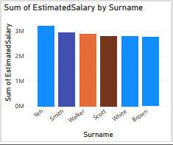
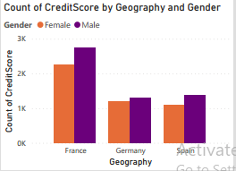
DATA EXPLORATION & ANALYTICS
AGE AND GENDER DISTRIBUTION OF CUSTOMERS
Male customers that live in France have the highest credit score
Top Six (6) customers with the highest estimated salary

Slide 9
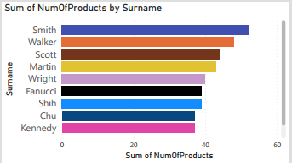
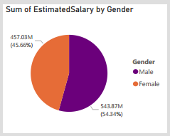
DATA EXPLORATION & ANALYTICS
PAYMENT METHOD AND CUSTOMER TYPE
Male customers have the highest estimated salary
Top Nine (9) customers with the highest number of products purchased

Slide 10
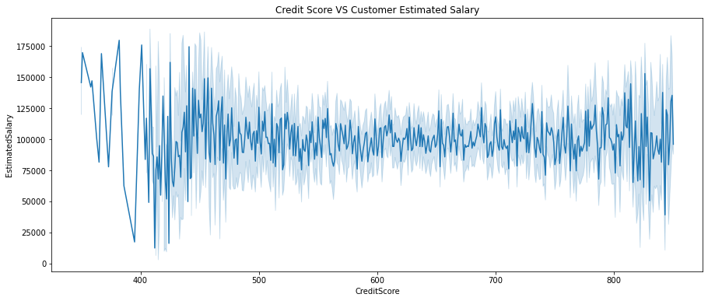
DATA EXPLORATION & ANALYTICS
The line shows there is a fairly constant relationship between credit worthiness and estimated salary of customers

Slide 11
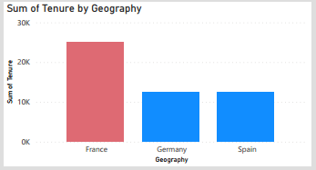
DATA EXPLORATION & ANALYTICS
Customers that live in France have the highest tenure with the company

Slide 12
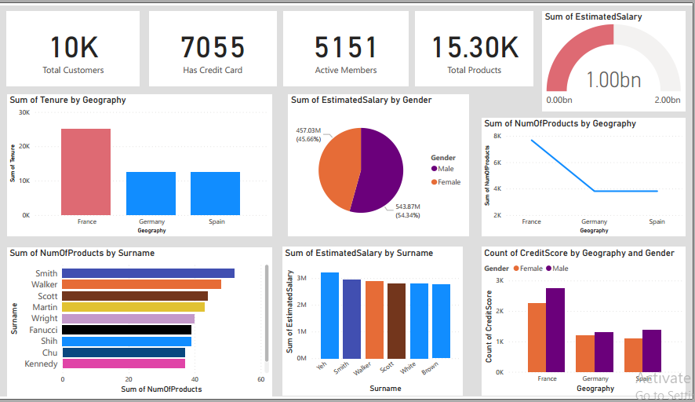
DATA VISUALIZATION

Slide 13

SUMMARY AND CONCLUSION
Credit worthiness has a direct positive relationship with account balance and the estimated salary of customers
France holds customers with the highest number of products purchased and credit worthiness
Active customers purchase slightly more products than inactive customers
Male customers have the highest amount of estimated salary

Slide 14



